Slide 1
AI-Powered Session Quiz
& Feedback System
AICA Level 2 Capstone Project
Ratti Rani | n8n + Google Gemini AI

Slide 2
The Problem
No fast way to check understanding
The Solution
1. Faculty submit topic + session notes
2. AI generates a bank of quiz questions
3. Students take a verified, single-attempt quiz
4. (Next phase) instant graded feedback
After every session, faculty have no quick way to check whether students absorbed the material, or spot class-wide weak concepts — until exam time, when it's too late.

Slide 3
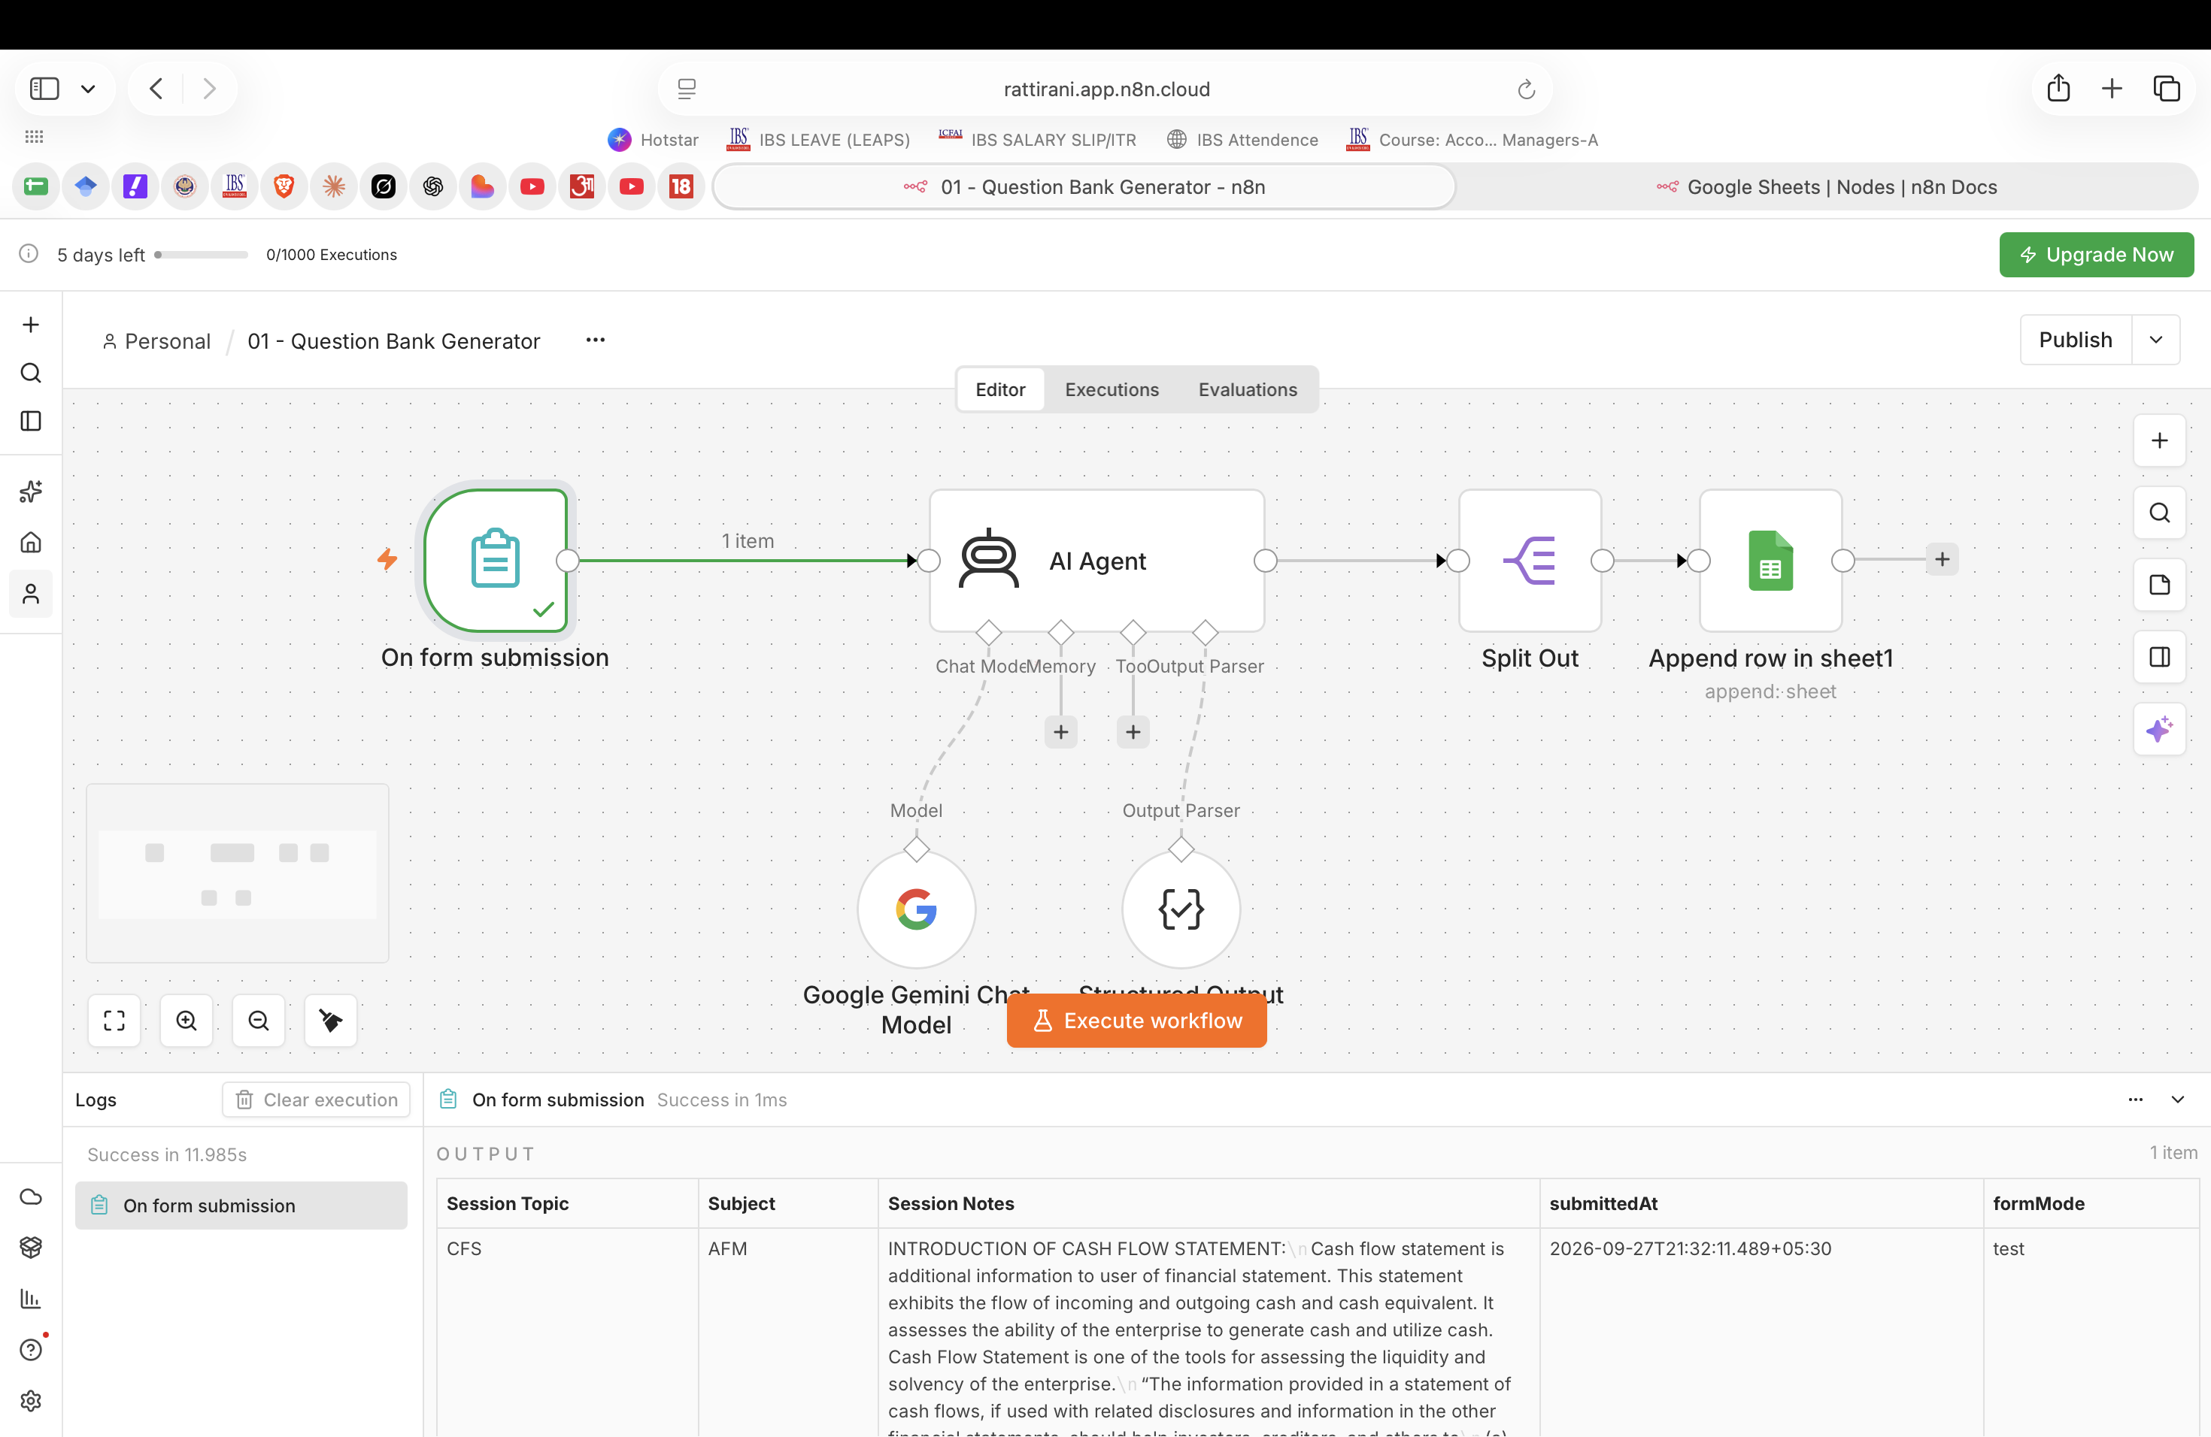
WORKFLOW 1 — QUESTION BANK GENERATOR
AI Agent Generates the Question Bank
Faculty submit topic + notes via a form
Gemini AI Agent generates 10 MCQs + 2 short-answer questions, tagged by concept
Structured Output Parser keeps the format strict and predictable
Split Out writes each question as its own row into Question_Bank

Slide 4
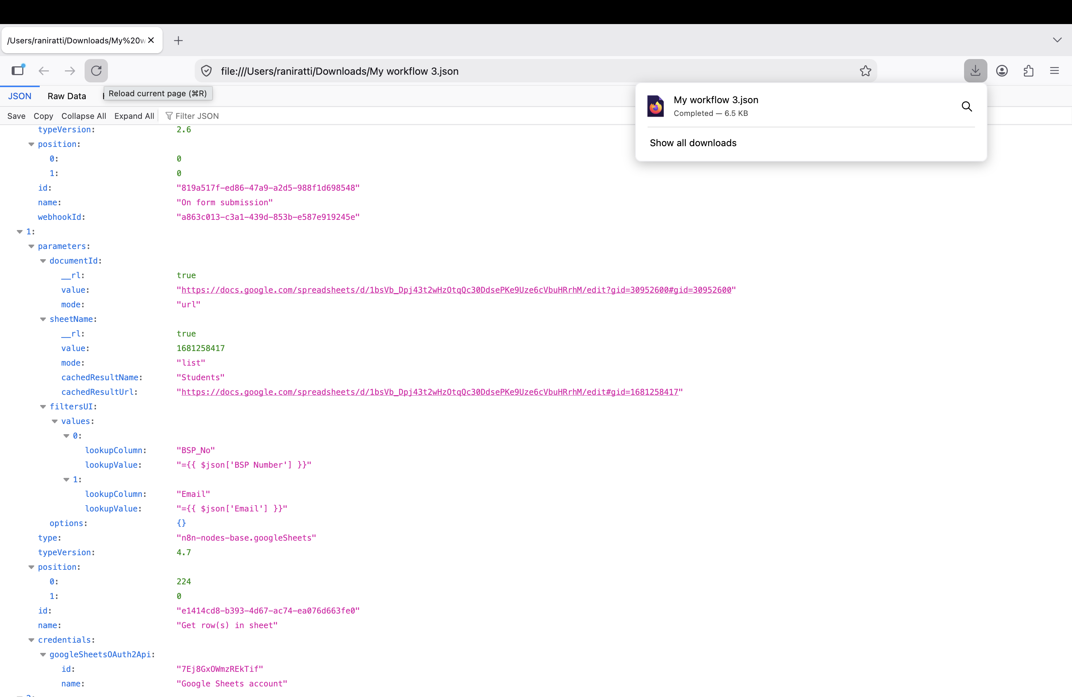
WORKFLOW 1 — RESULT
Real Questions Written to the Sheet
Each row: question, 4 options, correct answer
Model answer for short-answer questions
Concept tag + marks per question
Tested with 2 topics — 24 real questions generated

Slide 5
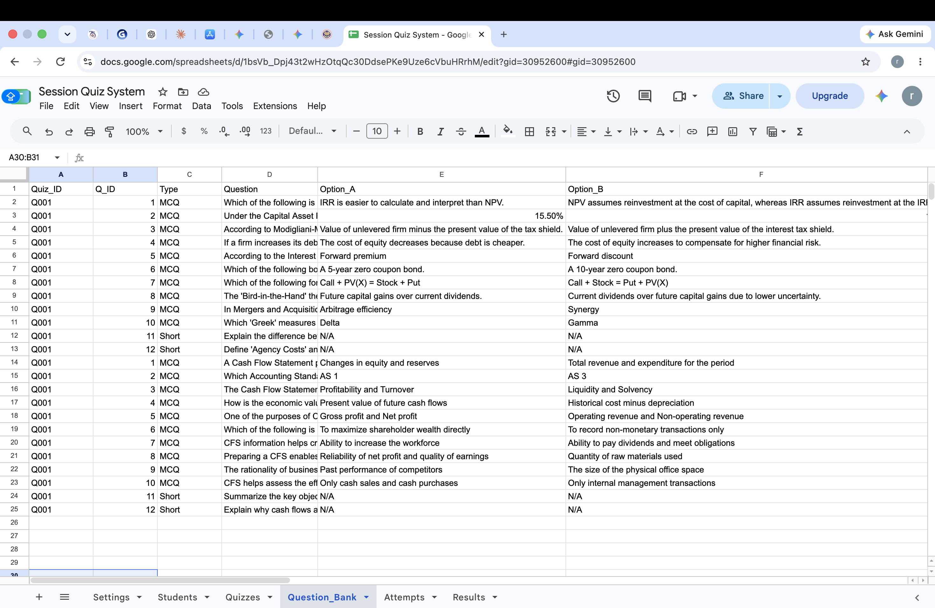
WORKFLOW 1 — TESTED
End-to-End Test Run
Full run executed successfully, no errors
Form submission → AI generation → sheet write, verified
Confirms the pipeline is production-ready for real sessions

Slide 6
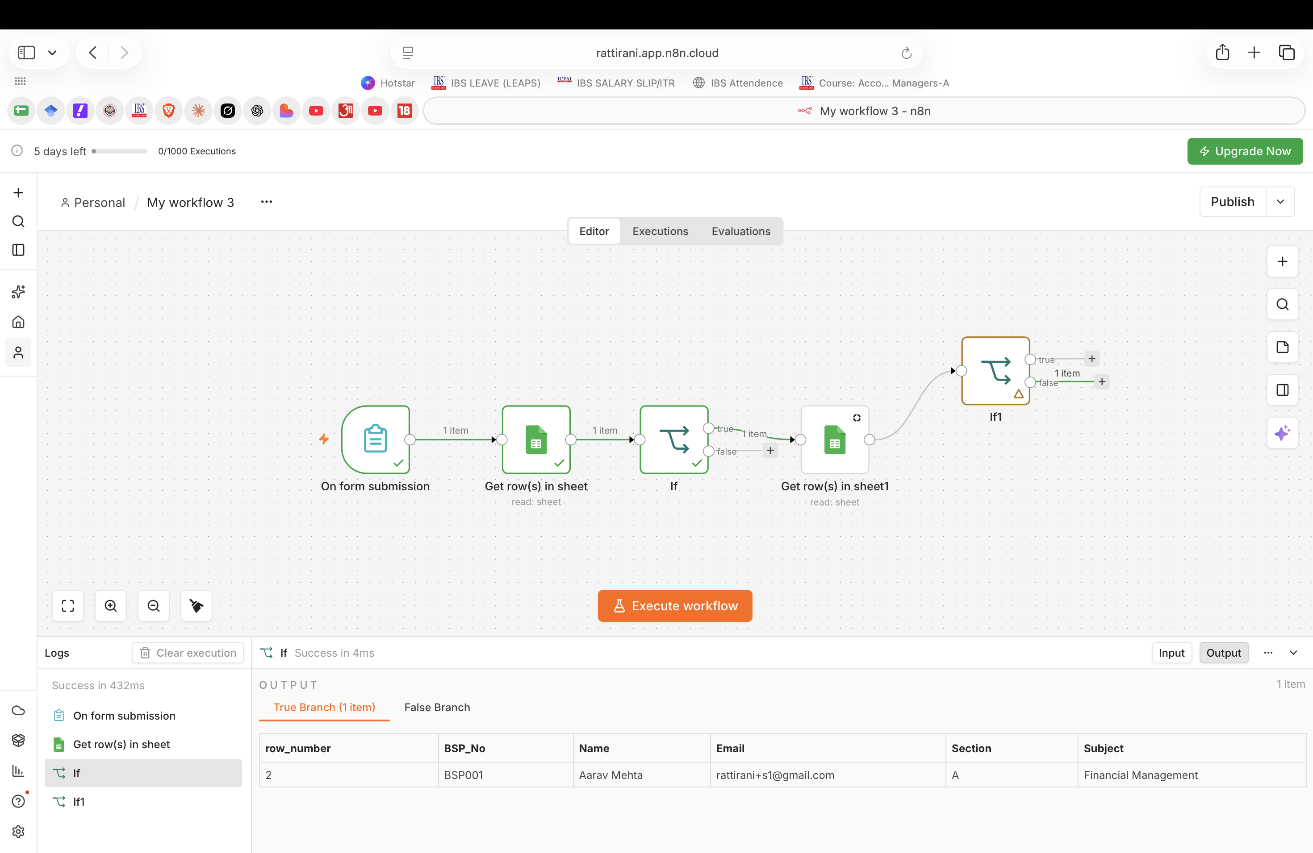
WORKFLOW 2 — ACCESS CONTROL
Verifying Students Before the Quiz
BSP number + email checked together against the Students sheet
A guessed ID alone cannot get in
Attempts sheet enforces one attempt per quiz
Faculty can manually allow a re-attempt in the sheet if needed

Slide 7
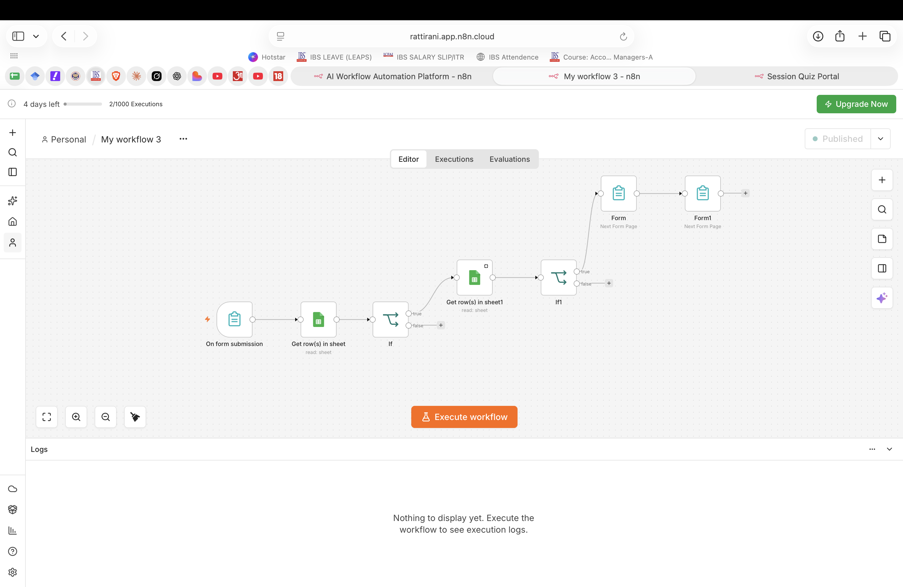
WORKFLOW 2 — FULL CANVAS
Registration → Verification → Quiz Delivery
Form submission triggers the workflow
Reads Students sheet, then an If node checks the match
Reads Attempts sheet, then a second If enforces one attempt
Cleared students proceed straight into the quiz form

Slide 8
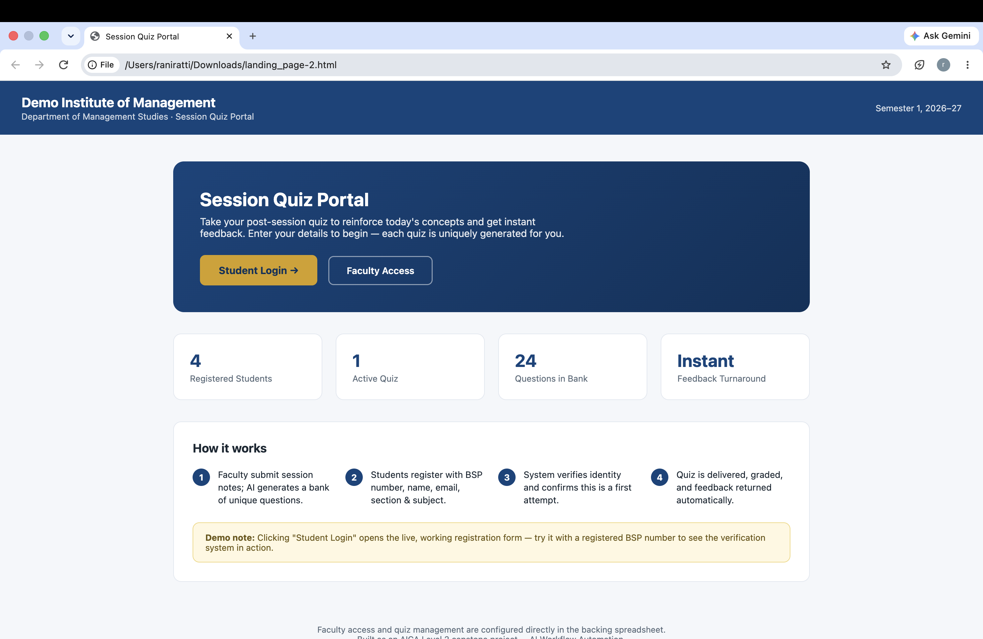
DEMO — LANDING PAGE
Where Students Start
Overview: registered students, active quiz, question bank size
"Student Login" opens the live registration form
Branding is fully configurable per institution

Slide 9
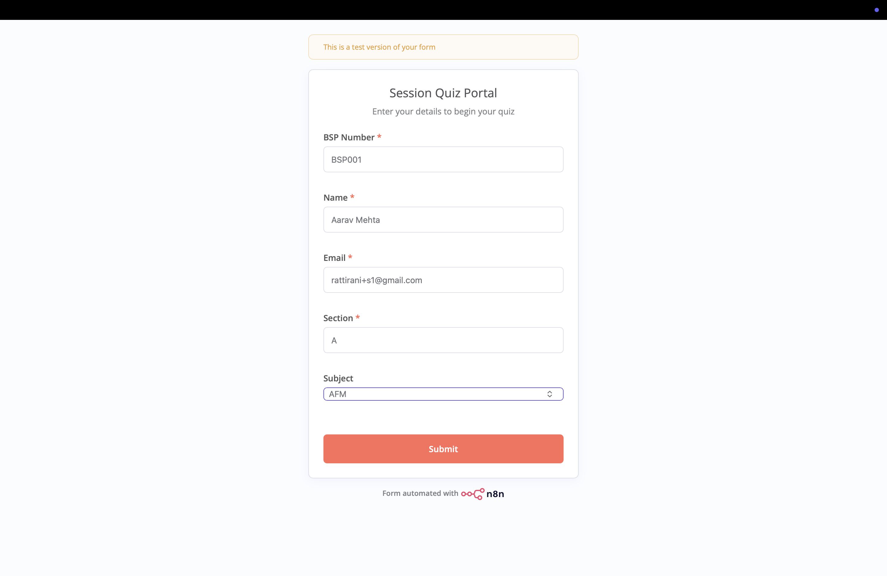
DEMO — REGISTRATION
Student Registration, Verified Against the Roster
Student fills BSP number, name, email, section, subject
Cross-checked against the Students sheet shown here
Both BSP number and email must match together

Slide 10
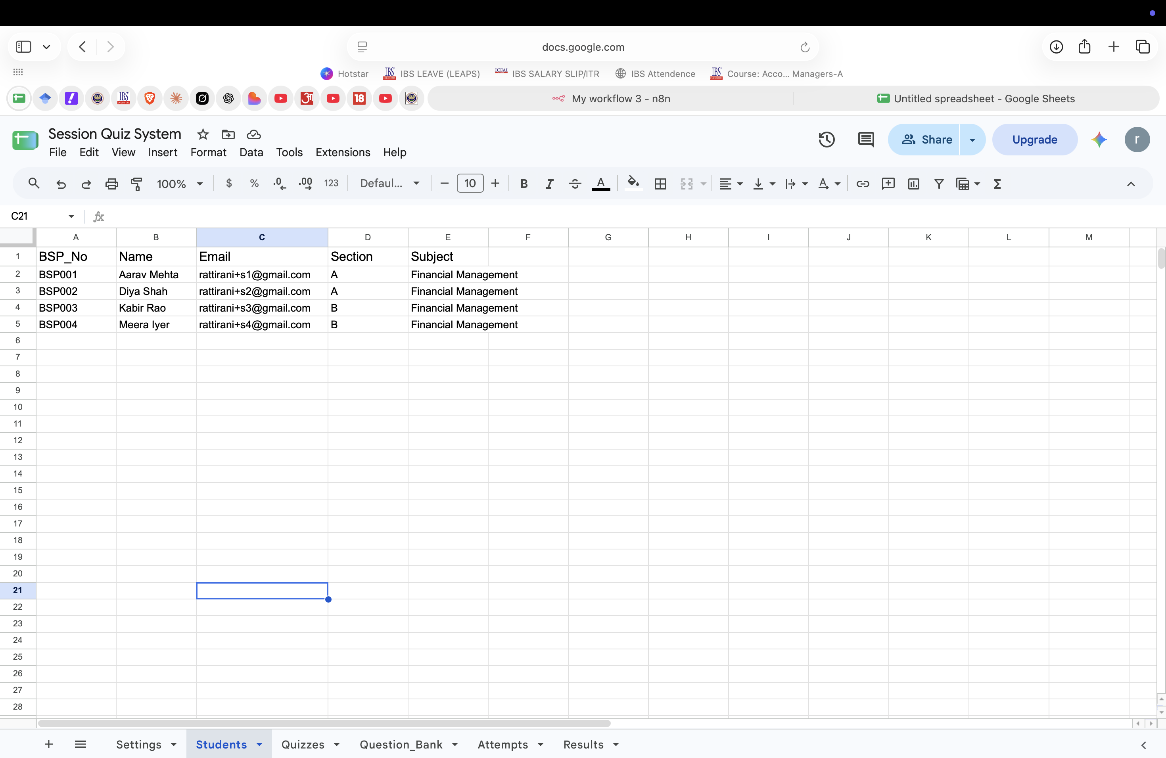
DEMO — STUDENTS SHEET
The Verification Source of Truth
Official roster: BSP number, name, email, section, subject
This is what registration is checked against
Faculty maintain this list directly — no code required

Slide 11
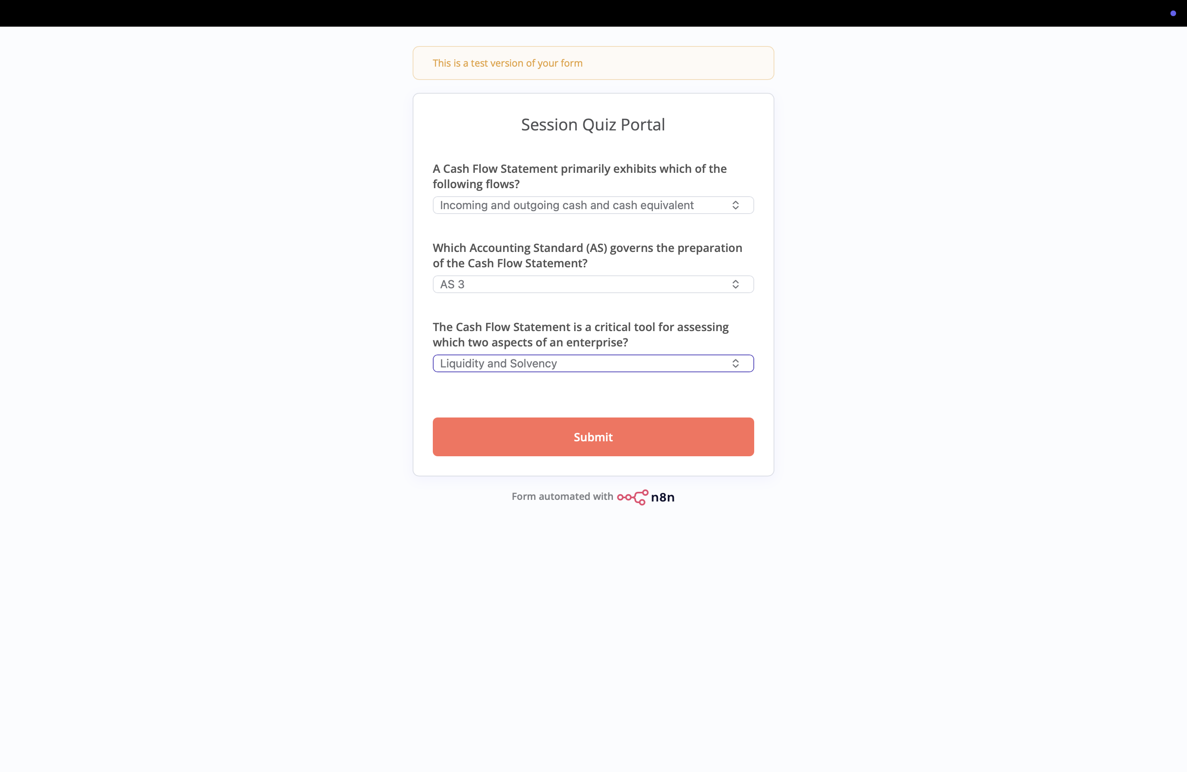
DEMO — QUIZ
Live Quiz — Page 1
Real questions pulled from Question_Bank
Topic: Cash Flow Statement
Three questions on page 1, answered here

Slide 12
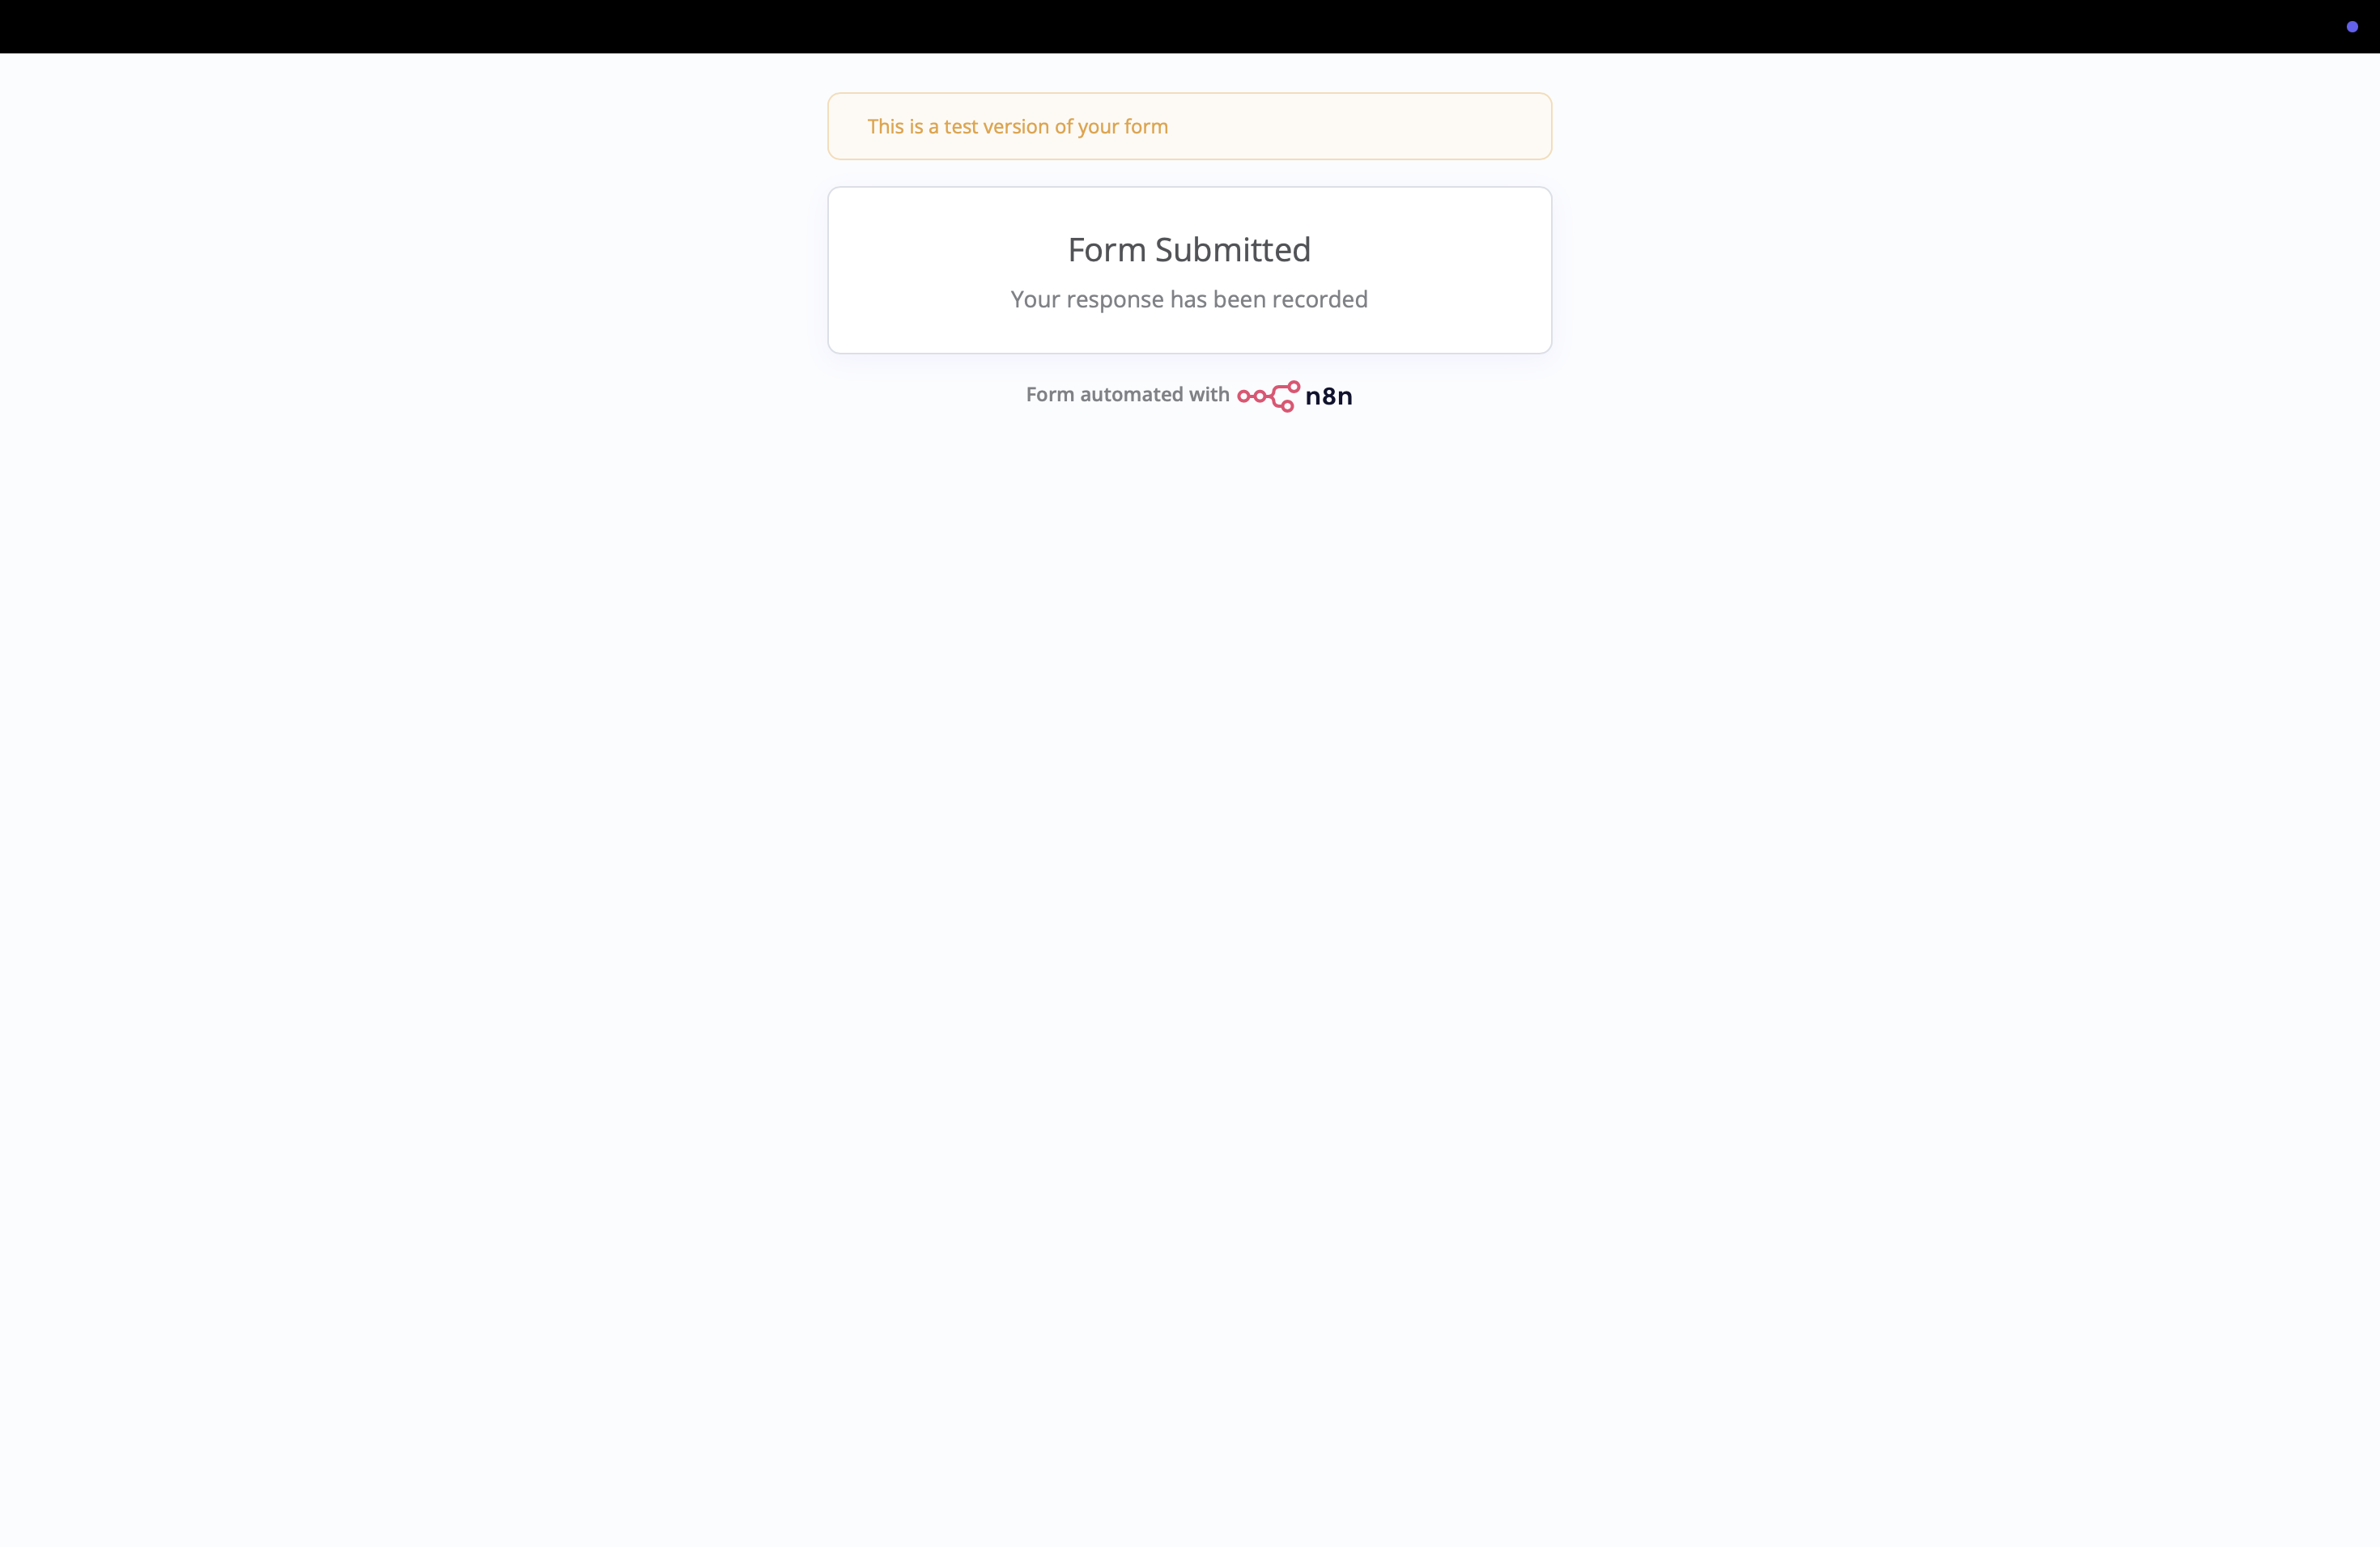
DEMO — QUIZ
Live Quiz — Page 2 & Submission
Second page: final question
Full journey tested end-to-end
Register → verify → answer → submit — confirmed working

Slide 13
What's Next
1
2
3
Randomization
Workflow 3
Faculty analytics
Randomize question and option order per student — no two students get an identical quiz.
Auto-grade MCQs, AI-evaluate short answers, and email personalized feedback.
A class-wide view of weak concepts, mapped to the Results sheet already.

Slide 14
Disclaimer
Academic prototype: This is an AICA Level 2 capstone project — a pilot/prototype, not a production system.
Test data only: All student records (BSP001–BSP004, names, emails) are fictitious, created for demonstration. No real student or institutional data was used.
AI-generated content: Quiz questions are generated by Google Gemini and have not been independently verified for factual or academic accuracy — faculty should review before real classroom use.

Slide 15
Thank You
AICA Level 2 skills applied: form triggers, AI agents with structured outputs, no-code data integration.
Fully configurable — deployable by any institution. Control stays with faculty, not the system.

